Slide 1
Customer Segmentation (CDACL-002)
Submitted by:
Laxmi Kaddoni
Tools Used: mysql |Excel| jupyter Notebook | Power BI

Slide 2
1.Introduction
This project focuses on customer segmentation based on purchase data.
Dataset size: 3900 records from U.S. market shoppers.
Goal: Understand customer behavior and design targeted marketing campaigns.
Importance: Helps businesses improve sales, loyalty, and discount strategies.
2.Objectives
Analyze spending patterns based on age, season, and location.
Perform clustering to group customers into 3+ segments.
Develop targeted marketing campaigns based on shopping trends.
Identify product categories where discounts should be applied.

Slide 3
3.Dataset Description
Demographics: Age, Gender, Location.
Purchase Details: Item, Category, Amount, Size, Color, Season.
CustomerBehavioral Data: Frequency of Purchases, Previous Purchases, Subscription Status.
Promotions: Discount Applied, Promo Code Used.
Other Attributes: Payment Method, Review Rating, Shipping Type.
4.Tools & Technologies
Data Extraction: SQL (to query and retrieve purchase data).
Data Cleaning & Preprocessing: Python (Pandas, NumPy).
Exploratory Data Analysis (EDA): Python (Matplotlib, Seaborn).
Clustering & Segmentation: Python (Scikit-learn -K-means).
Visualization & Reporting: Power BI.
Documentation & Presentation: MS PowerPoint.

Slide 4
5. Project Workflow
Data Collection: Extract purchase data using SQL.
Data Cleaning: Handle missing values, encode categorical variables, normalize numerical data.
Exploratory Data Analysis (EDA): Identify spending patterns by age, season, and location.
Discount Strategy: Determine categories where discounts are most effective.
Clustering: Apply K-means to segment customers into groups.
Insights & Campaigns: Design targeted marketing strategies for each cluster.
Visualization & Reporting: Create dashboards and present findings to client.

Slide 5
6.Data Extraction
SQL-based data extraction involves retrieving structured customer data from a relational database using SQL queries for analysis and reporting purposes.
7.Database Overview
The customer shopping dataset was stored in a relational database table containing customer demographic, transactional, and behavioral information required for segmentation analysis.

Slide 6
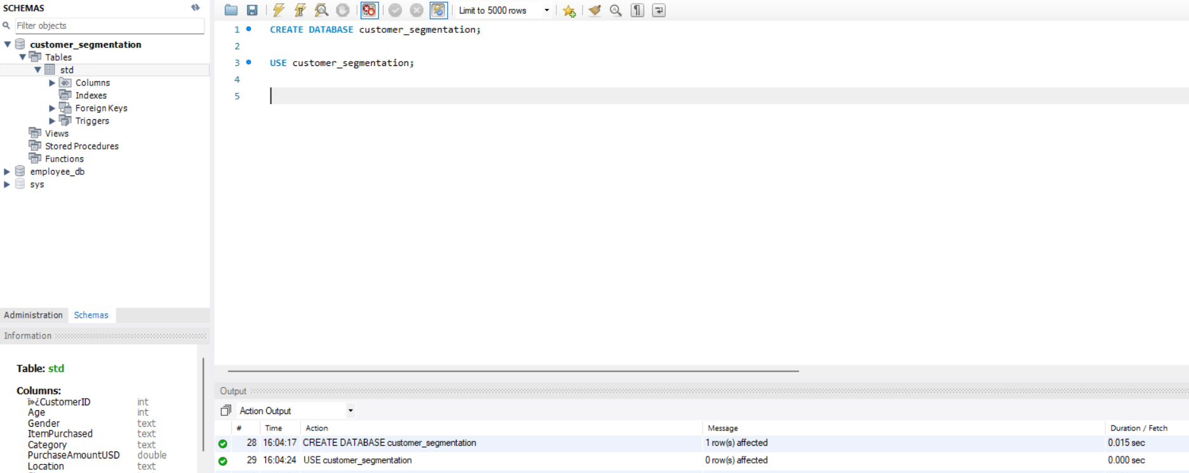
8.Database Creation

Slide 7
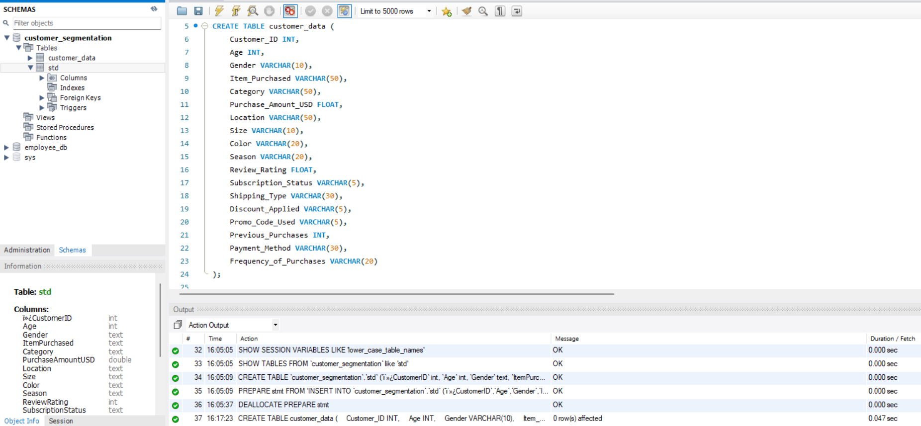
9.Customer Data Table Creation

Slide 8
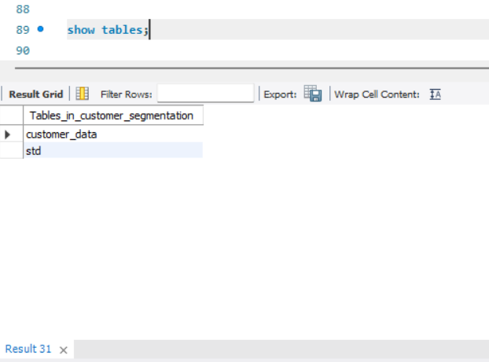
10.Verifying Created Tables

Slide 9
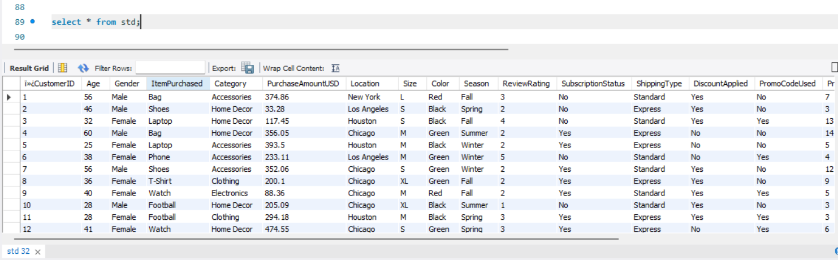
11.Customer Data Preview

Slide 10
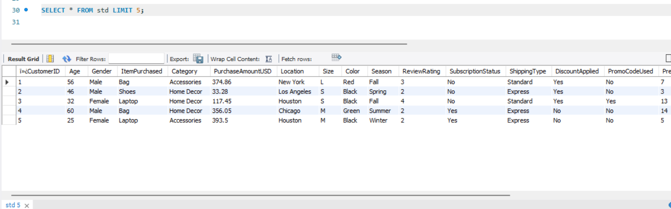
12.Preview Extracted Data

Slide 11
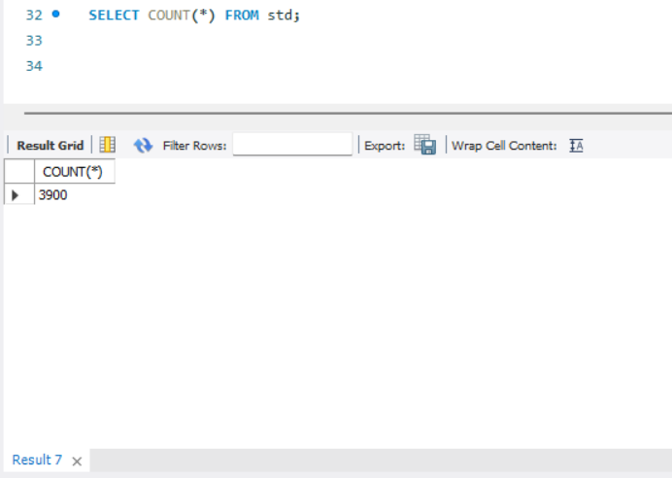
13.Record Count Validation

Slide 12
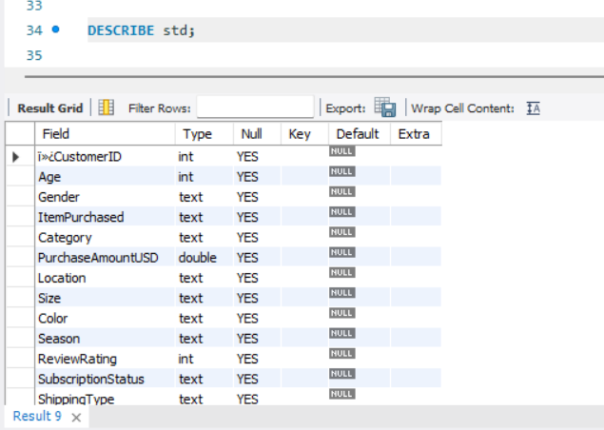
14.Table Schema Inspection

Slide 13
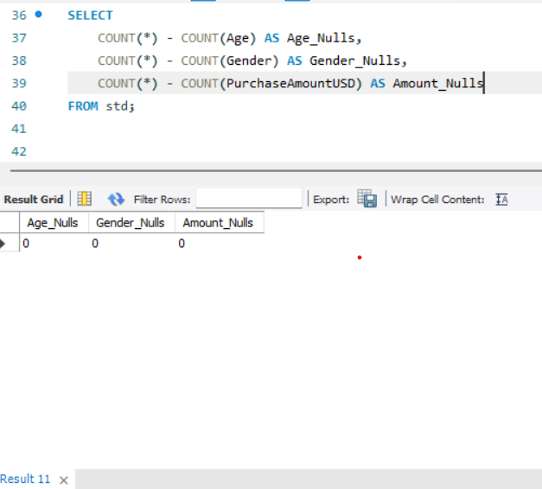
15.Missing Values Check

Slide 14
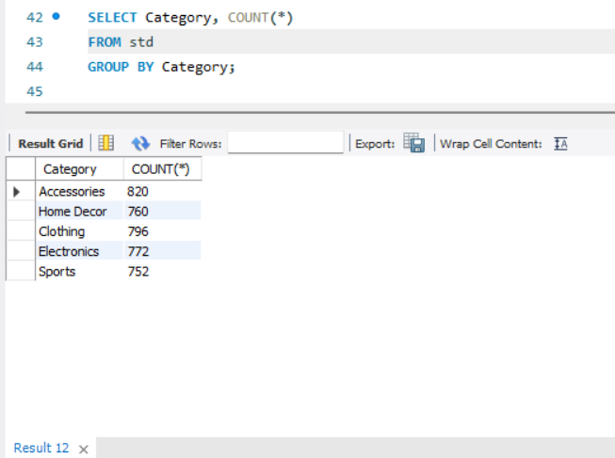
16.Category-wise Purchase Extraction

Slide 15
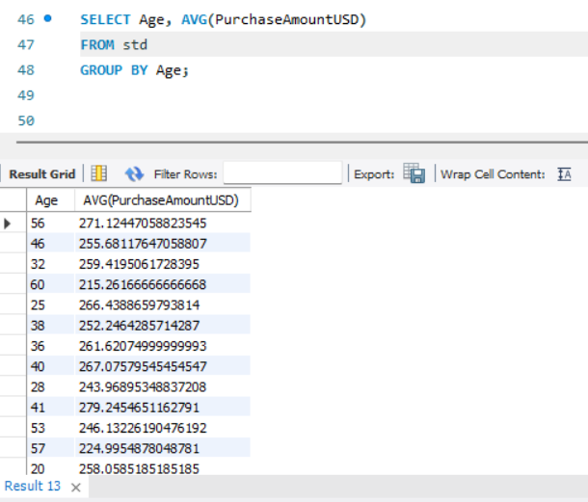
17.Age-wise Average Spending

Slide 16
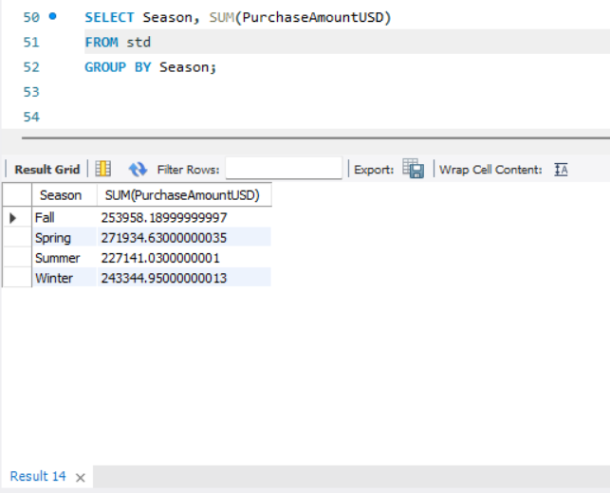
18.Season-wise Sales Data

Slide 17
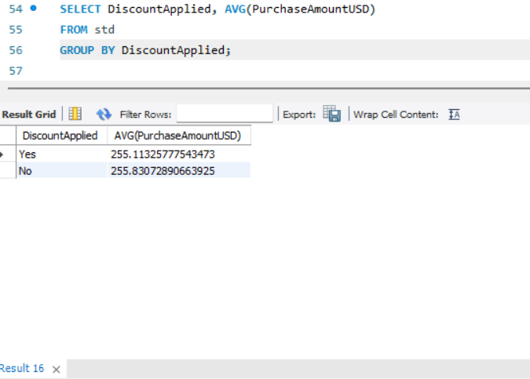
19.Discount Applied vs Purchase Amount

Slide 18
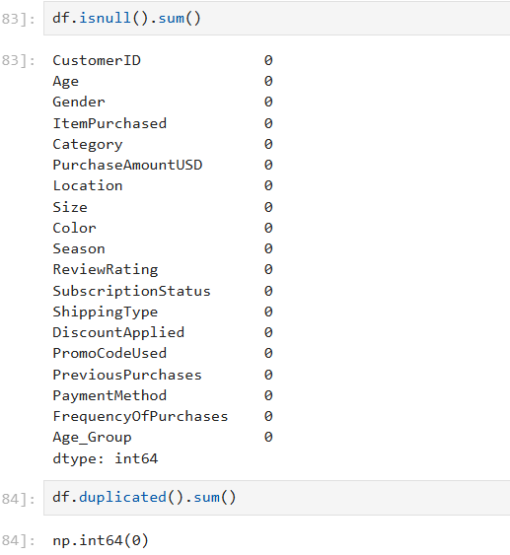
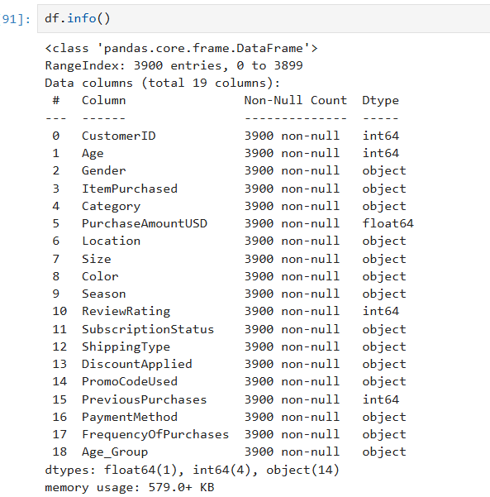
20.Data Cleaning Process

Slide 19
Checked null values
Checked duplicates
Cleaned column names
Converted datatypes
21.insights
No missing values found
No duplicate records
Dataset contains 3900 records and 19 features
Dataset is clean and ready for analysis

Slide 20
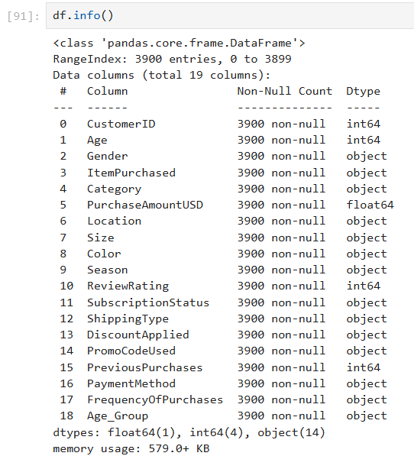
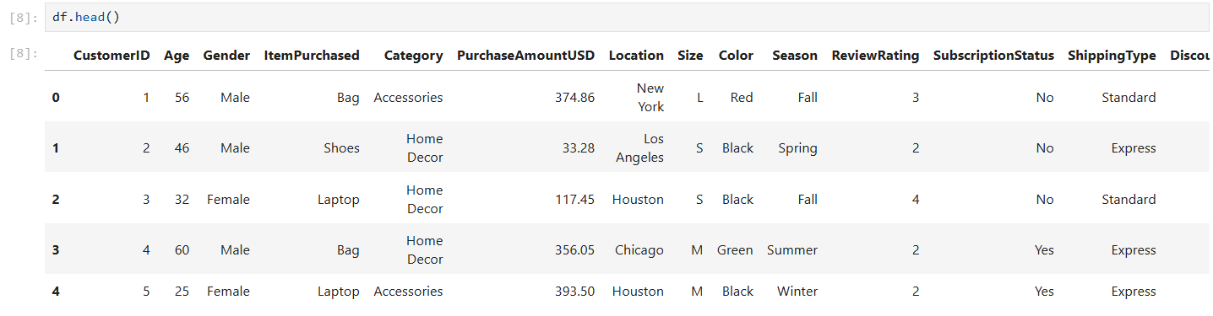
22.Dataset Overview and Structure
This section provides an overview of the dataset, including the number of records,
features, and data types after cleaning.

Slide 21
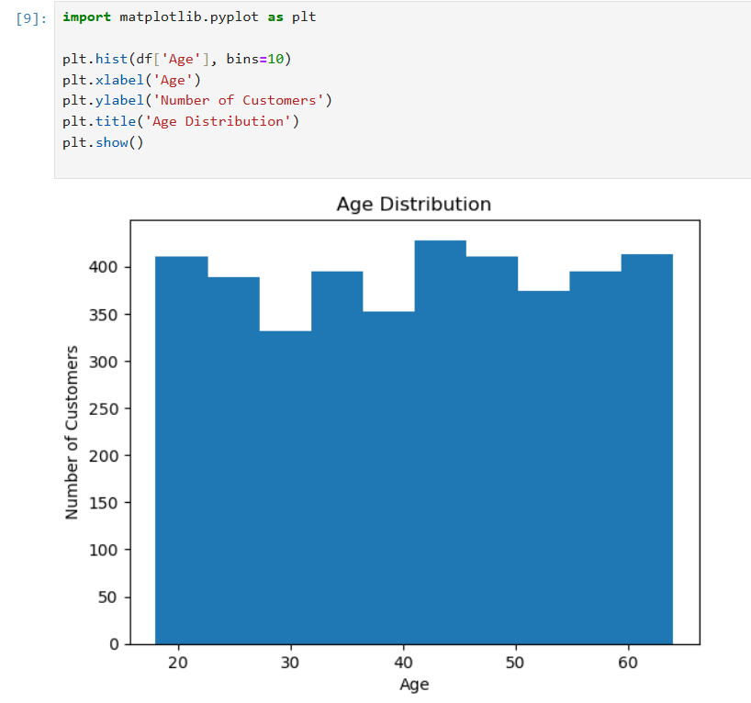
23.Customer Age Distribution
Analyze how customers are distributed across different age ranges.
Insight
Most customers fall between the 26–40 age group, indicating a strong working-age customer base.

Slide 22
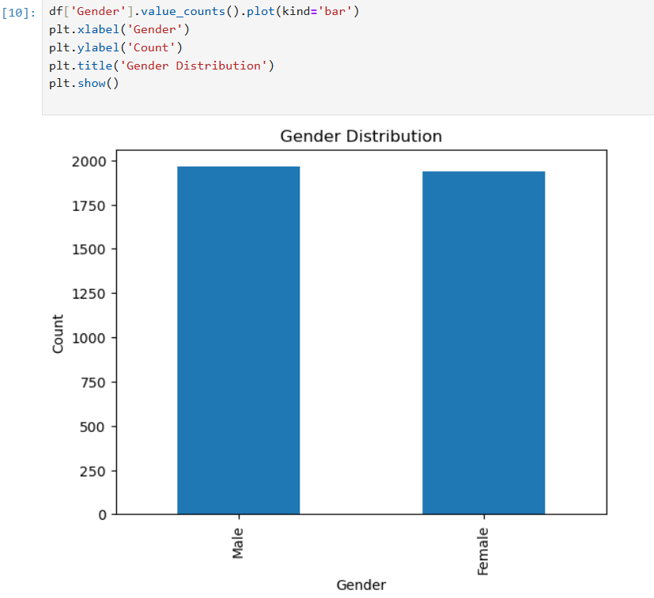
24.Gender-wise Customer Distribution
Understand gender representation among customers.
Insight
Male and female customers are nearly equally represented.

Slide 23
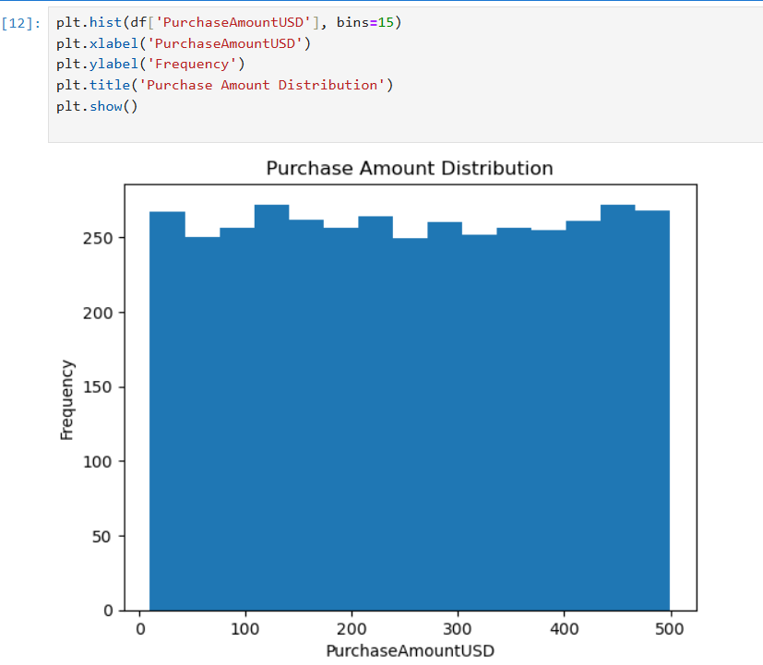
25.Purchase Amount Distribution
Analyze how purchase amounts vary among customers.
Insight
Most purchases are within a moderate range, with a few high-value transactions.

Slide 24
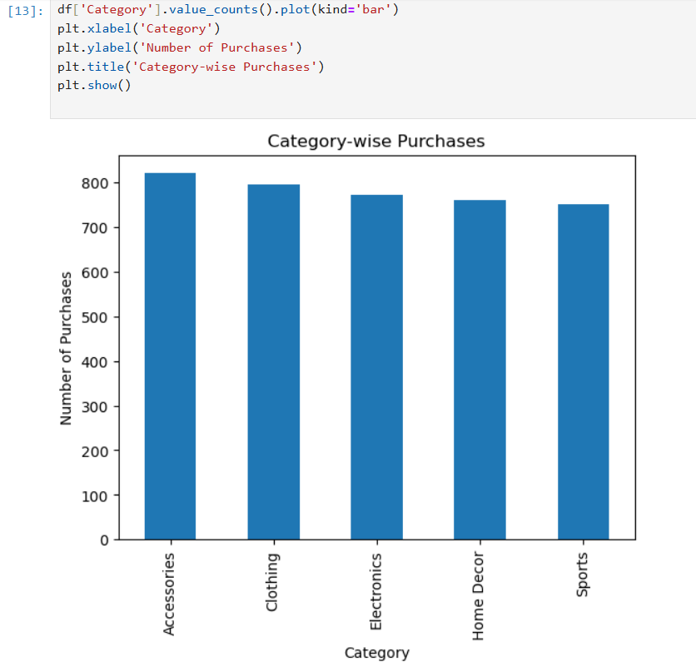
26.Product Category Analysis
Identify the most frequently purchased product categories.
Insight
Clothing and accessories dominate customer purchases.

Slide 25
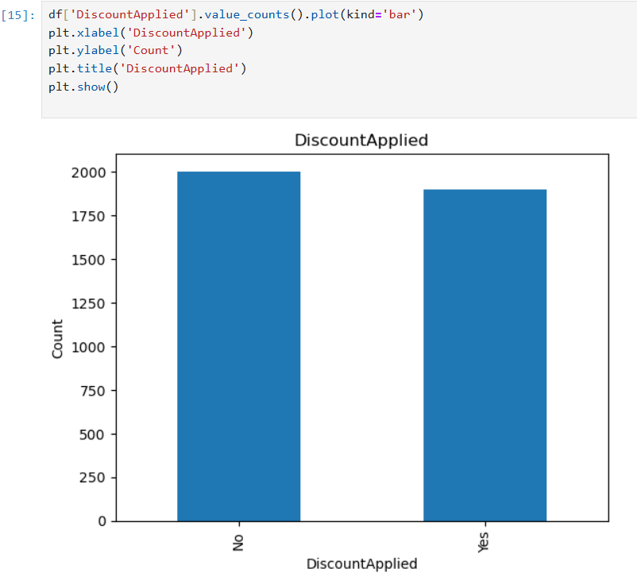
27.Impact of Discounts on Purchases
Understand how discounts affect customer purchases.
Insight
A significant number of customers respond positively to discounts.

Slide 26

28.Promo Code Usage by Customers
Analyze customer interaction with promotional offers.
Insight
Promo codes are actively used, especially by frequent shoppers.

Slide 27
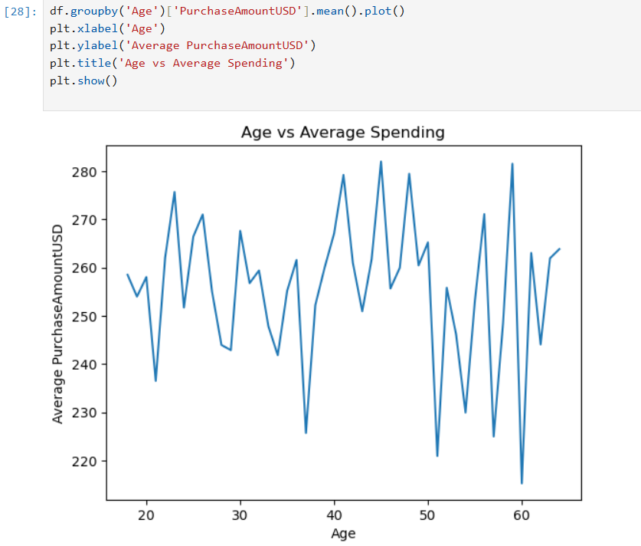
29.Age vs Spending Pattern
Analyze how spending varies across age groups.
Insight
Customers aged 26–40 show the highest average spending.

Slide 28
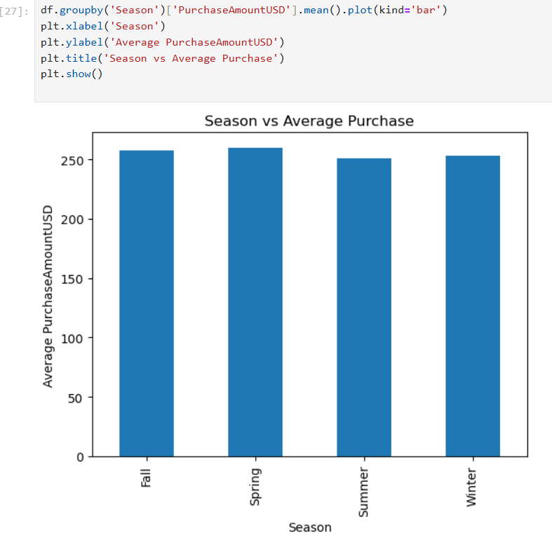
30.Seasonal Shopping Trends
Understand how seasons impact customer purchases.
Insight
Winter and Fall seasons record the highest average sales.

Slide 29
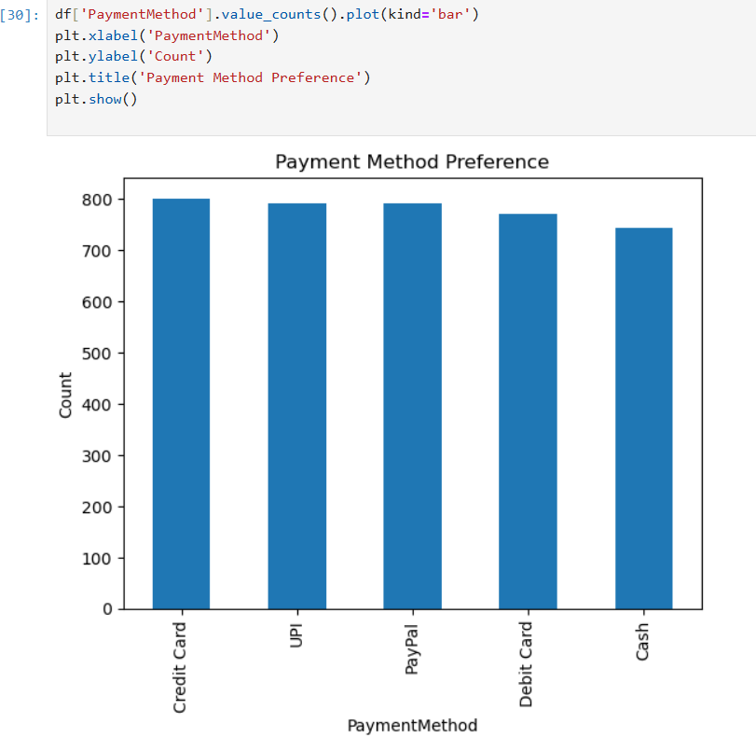
31.Preferred Payment Methods
Analyze customer payment preferences.
Insight
Card-based payments are the most preferred method.

Slide 30
32.Key Insights from EDA
Discounts are effective in fashion-related categories
Customers aged 26–40 generate maximum revenue
Seasonal demand peaks in Winter and Fall
Promo codes influence younger customers

Slide 31
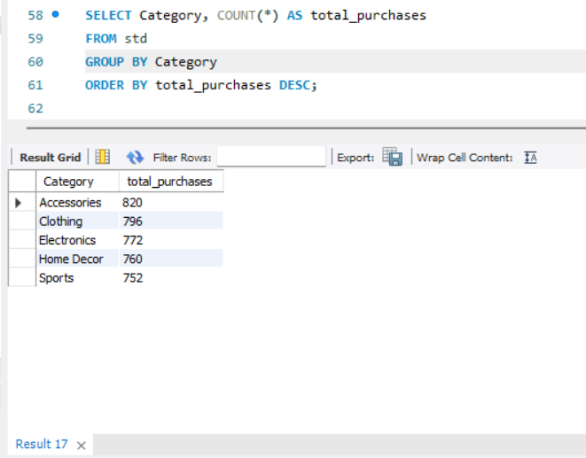
33.High Demand Product Categories
Business reasoning
High-demand categories benefit from small discounts as they increase sales volume and repeat purchases. Discounts here function as a growth driver, not a revenue risk.

Slide 32
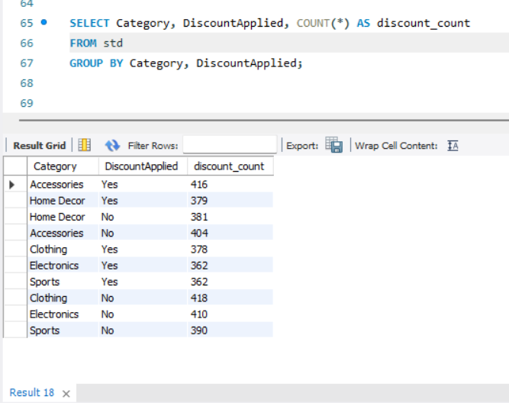
34.Category-wise Discount Usage Comparison
Business reasoning
Low discount exposure in high-demand categories presents an opportunity. Targeted discounts can increase basket value and loyalty without impacting margins.

Slide 33
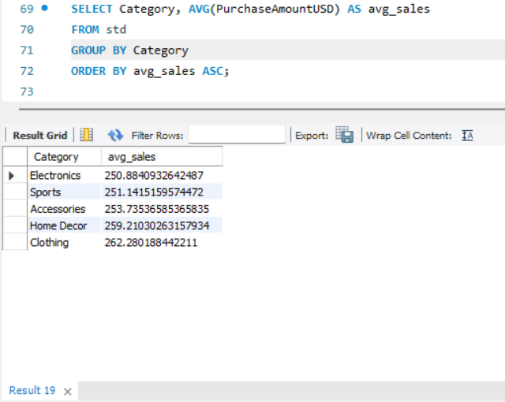
35.Low Sales but High Potential Categories
Business reasoning
Low-sales but high-potential categories benefit from discounts that reduce price hesitation and convert browsers into buyers.

Slide 34
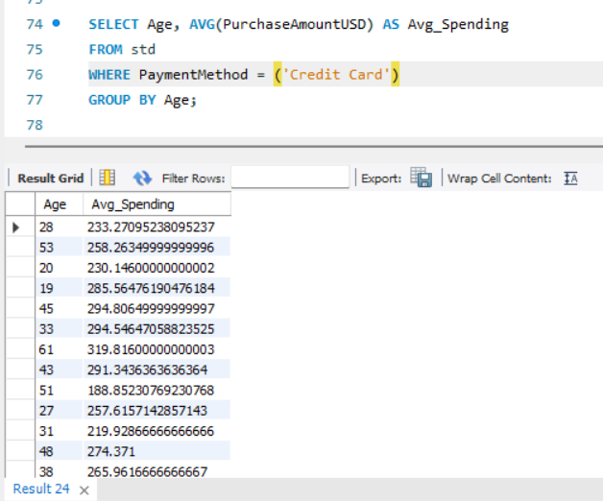
36.Card Spending by Age
Business Insights
Middle-age customers spend more using cards
Younger customers use cards but spend less per transaction
Older customers spend occasionally but on higher-value items

Slide 35
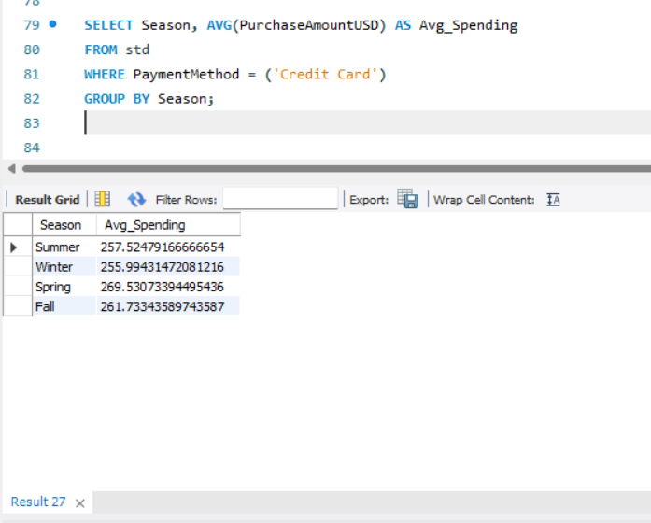
37.Season-wise Card Spending
Business Insights
Winter and Fall show highest card spending
Festive and seasonal shopping increases card usage
Summer shows moderate spending

Slide 36
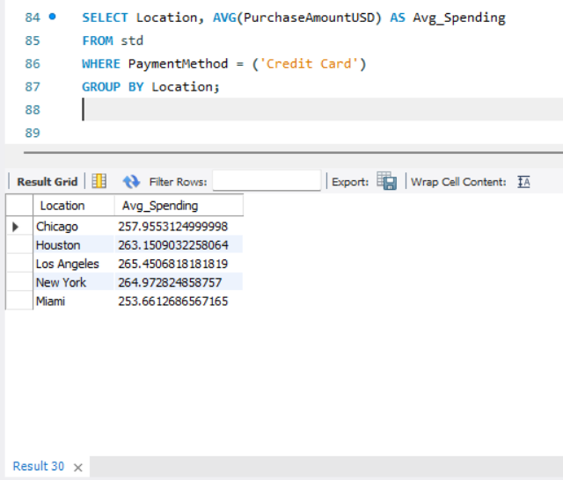
38.Location-wise Card Spending
Business Insights
Urban locations show higher card spending
Customers in developed regions prefer digital payments
Some locations show low card usage → growth opportunity

Slide 37
39.Feature Selection for Customer Clustering
Features Used
Age
PurchaseAmountUSD
PreviousPurchases
FrequencyOfPurchases

Slide 38
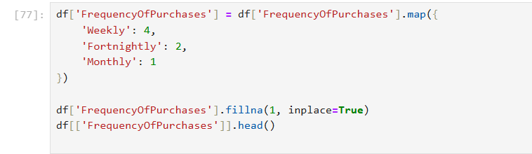
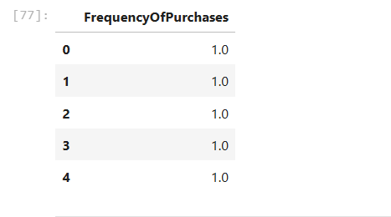
40. Feature Encoding

Slide 39
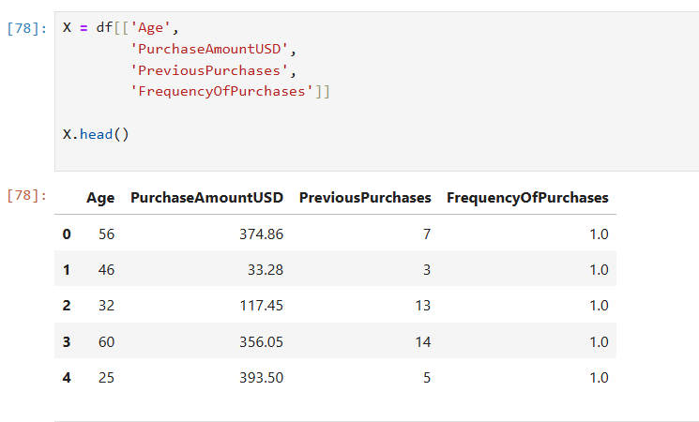
41.Feature Selection

Slide 40
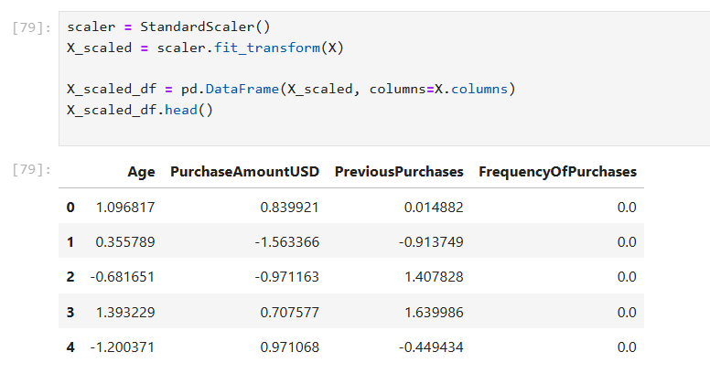
42.Data Scaling

Slide 41
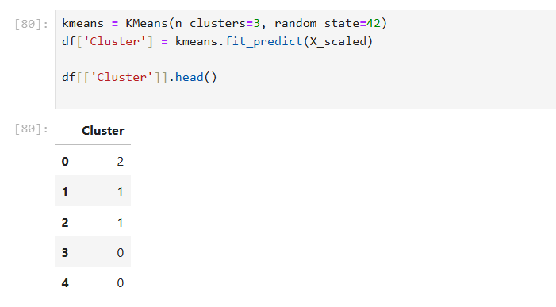
43.K-Means Model Implementation

Slide 42
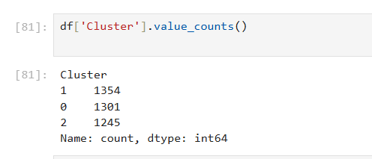
44.Cluster Size Analysis

Slide 43
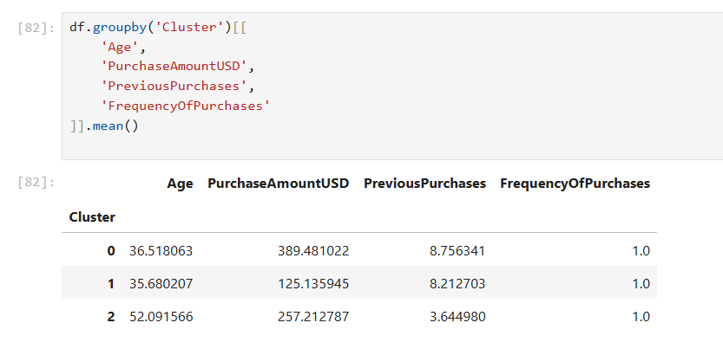
45.Cluster Summary Statistics

Slide 44
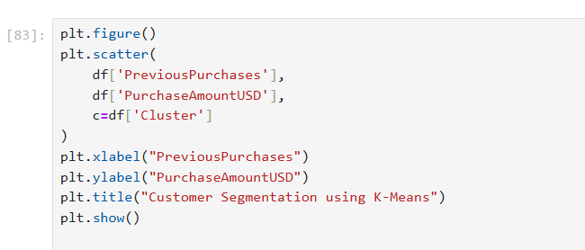
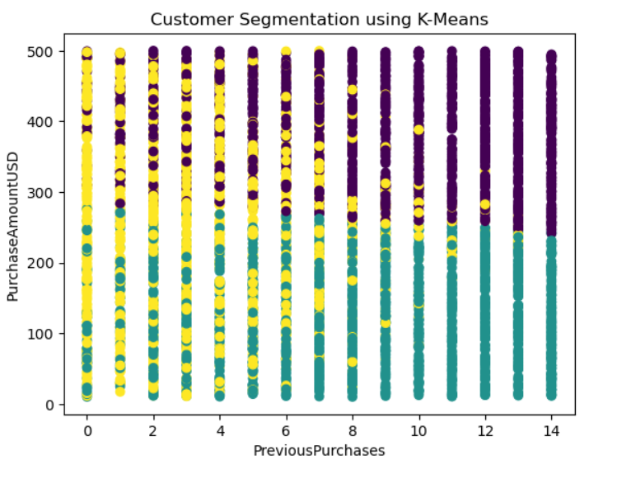
46.Customer Cluster Visualization

Slide 45
47.Final Cluster Interpretation
Cluster 0 – High Spenders
High purchase amount
Frequent buyers
Loyal customers
Action: Loyalty rewards, premium offers
Cluster 1 – Budget Customers
Low spending
Infrequent purchases
Action: Discounts, promo codes
Cluster 2 – Seasonal Buyers
Moderate spending
Purchase during specific seasons
Action: Seasonal campaigns

Slide 46
48.Interactive Dashboard for Customer Insights
Visualize sales performance
Understand customer spending patterns
Support discount and marketing decisions

Slide 47
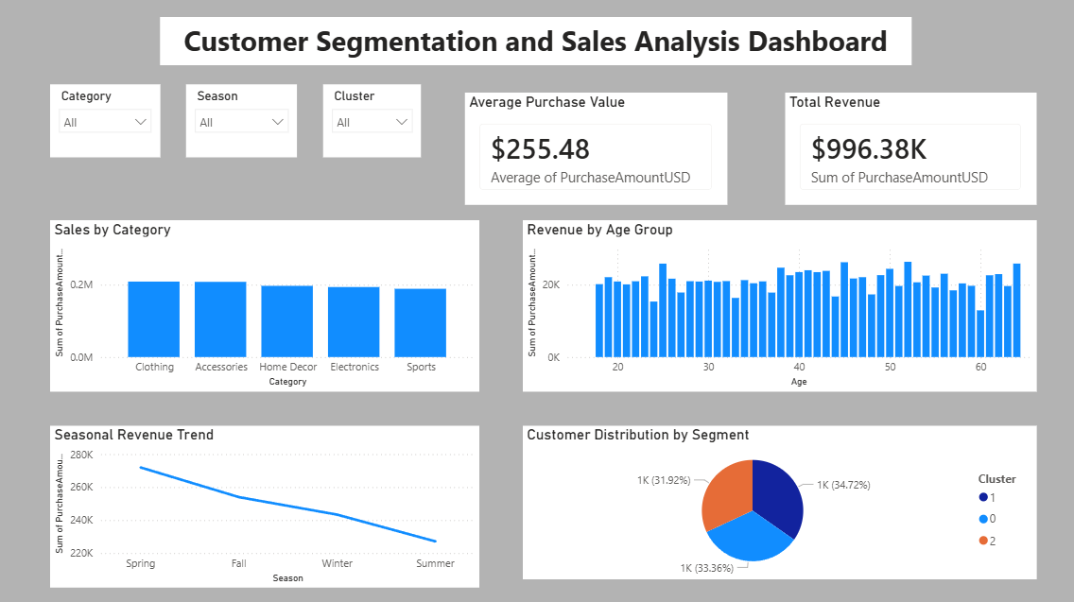
49.Customer Segmentation & Sales Insights Dashboard

Slide 48
50.DASHBOARD Key INSIGHTS
🔹 Insight 1: Revenue Performance
Total revenue shows strong contribution from repeat customers
Average purchase value indicates steady customer spending behavior
🔹 Insight 2: Category-wise Sales
Few product categories generate majority of revenue
These categories should be prioritized for inventory and promotions
🔹 Insight 3: Age vs Spending Pattern
Middle-aged customers contribute the highest spending
Younger customers show lower spending but higher growth potential
🔹 Insight 4: Seasonal Revenue Trend
Sales peak during specific seasons indicating seasonal buying behavior
Seasonal campaigns can significantly improve overall revenue

Slide 49
🔹 Insight 5: Customer Cluster Distribution
High spenders form a smaller but high-value customer segment
Budget customers form the largest group and are discount-sensitive
Seasonal buyers purchase occasionally and respond to time-based offers
🔹 Insight 6: Business Impact
Customer segmentation enables targeted marketing strategies
Data-driven discounts improve sales efficiency and customer retention

Slide 50
51.Targeted Marketing Recommendations Based on Customer Segments
Design customized marketing strategies using customer clusters
Improve customer retention, conversion, and revenue
Cluster 0: High Spenders
Customer Characteristics
High purchase amount
Frequent and repeat purchases
High customer lifetime value
Recommended Strategy: Loyalty Rewards
Actions
Exclusive membership programs
Reward points and cashback offers
Early access to new products
Personalized premium recommendations
Business Reasoning
High spenders generate maximum revenue. Retaining them costs less than acquiring
new customers, making loyalty programs highly profitable.

Slide 51
Cluster 1: Seasonal Buyers
Customer Characteristics
Moderate spending
Purchases concentrated in specific seasons
Event or festival-driven behavior
Recommended Strategy: Seasonal Discounts
Actions
Festival and holiday discounts
Time-bound promotional offers
Seasonal email and SMS campaigns
Business Reasoning
Seasonal buyers respond strongly to time-based offers. Targeting them during peak
periods maximizes conversion and boosts seasonal revenue.

Slide 52
Cluster 2: Budget Customers
Customer Characteristics
Low purchase amount
Infrequent buyers
Price-sensitive
Recommended Strategy: Promotional Campaigns
Actions
Discount coupons and promo codes
Flash sales and bundle offers
First-time buyer discounts
Business Reasoning
Budget customers are price-driven. Promotional offers reduce purchase hesitation
and help convert them into repeat customers.

Slide 53
52.Skills Demonstrated in This Project
Data Cleaning and Preprocessing
SQL Query Writing and Data Extraction
Data Visualization and Storytelling
Customer Segmentation using Clustering Techniques
Business Strategy and Marketing Recommendations
Interactive Dashboard Design (Power BI)

Slide 54
53.Future Scope
Integrate real-time data to analyze customer behavior and purchase trends dynamically.
Apply advanced machine learning models (such as Random Forest or XGBoost) for more accurate customer segmentation and demand prediction.
Include additional customer attributes like location, income level, and device usage for deeper insights.
Automate the dashboard to refresh data periodically using scheduled data pipelines.
Perform sentiment analysis on customer reviews to understand customer satisfaction and preferences.
Extend the analysis to predict customer churn and design proactive retention strategies.
Deploy the dashboard as a web application for easy access by business stakeholders.

Slide 55
54.Conclusion
This project successfully analyzed customer purchasing behavior using data cleaning, visualization, and clustering techniques. By applying K-Means clustering, customers were segmented into meaningful groups such as high spenders, seasonal buyers, and budget customers. These insights helped identify buying patterns, spending habits, and demand across different categories.
The interactive Power BI dashboard provided a clear view of key business metrics, enabling data-driven decision-making. Based on the analysis, targeted marketing strategies were recommended, such as loyalty programs for high-value customers, seasonal discounts, and promotional offers for price-sensitive customers. Overall, this project demonstrates how data analytics can support better business strategies, improve customer engagement, and drive revenue growth.

